Slide 1
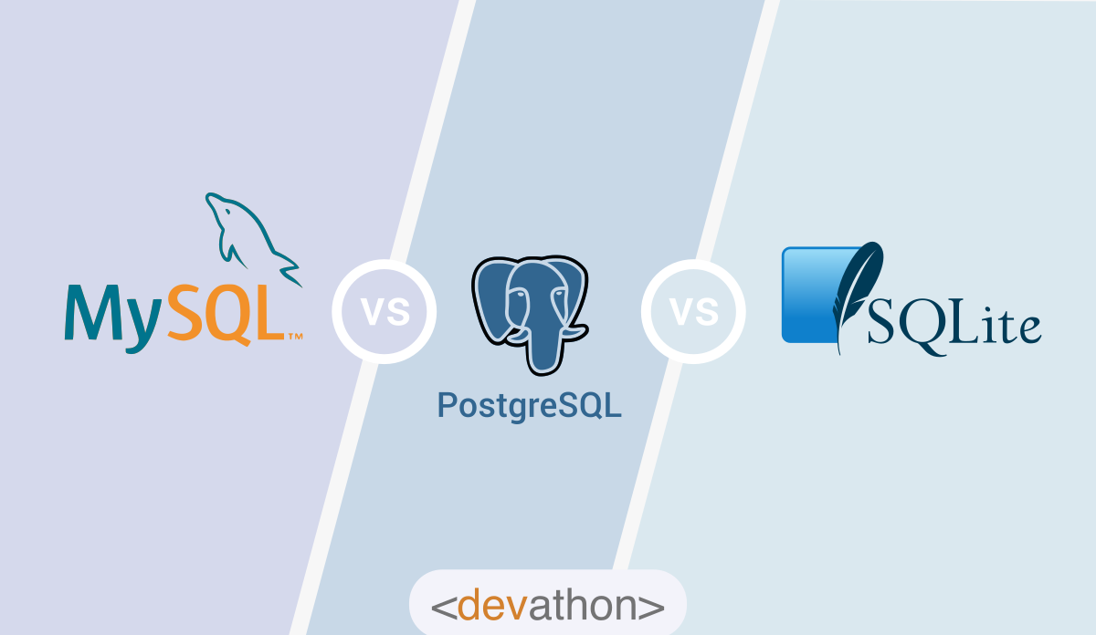
MYSQL STGRQL AND SQLSERVER

Slide 2
MySQL

Slide 3
MySQL is an open source SQL relational database management
system that’s developed and supported by Oracle. MYSQL MySQL has
stand-alone clients that allow users to interact directly with a
MySQL database using SQL, but more often MySQL is used with other
programs to implement applications that need relational database
capability. MySQL is a component of the LAMP web application software stack
(and others), which is an acronym for
Linux, Apache, MySQL, Perl/PHP/Python. MySQL is used by many
database-driven web applications, including Drupal, Joomla, phpBB, and WordPress.
MySQL is also used by many popular websites, including
Facebook,Flickr, MediaWiki,Twitter, and YouTube.

Slide 4
PostgreSQL

Slide 5
PostgreSQL also known as Postgres, is a free and open-source relational database management
system (RDBMS) emphasizing extensibility and SQL compliance.
It was originally named POSTGRES, referring to its origins as a successor to the
Ingres database developed at the University of California, Berkeley. In 1996,
the project was renamed to PostgreSQL to reflect its support for SQL. After a review in 2007,
the development team decided to keep the name PostgreSQL and the
alias Postgres.POSTGRESQL PostgreSQL features transactions with Atomicity, Consistency,
Isolation, Durability (ACID) properties, automatically updatable views, materialized views,
triggers, foreign keys, and stored procedures.It is designed to handle a range
of workloads, from single machines to data warehouses or Web
services with many concurrent users. It is the default database for macOS Server
and is also available for Windows, Linux, FreeBSD, and OpenBSD

Slide 6
SQL SERVER

Slide 7
Microsoft SQL Server is a relational database management
system developed by Microsoft. As a database server, it is a
software product with the primary function of storing and retrieving data as requestd
by other software applications—which may run either on the same computer or
on another computer across a network (including the Internet). Microsoft markets at
least a dozen different editions of Microsoft SQL
Server, aimed at different audiences and for workloads ranging from small
single-machine applications to large Internet-facing applications with many
concurrent users.

Slide 8
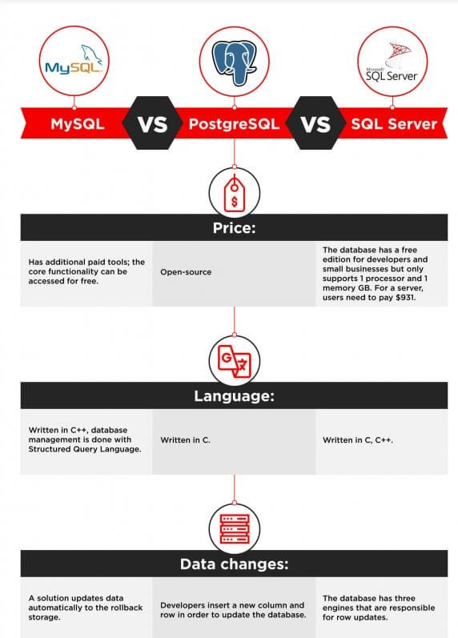

Slide 9
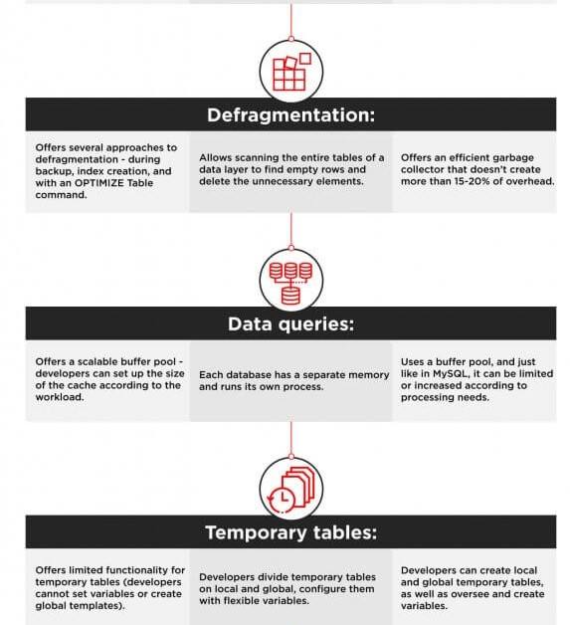

Slide 10
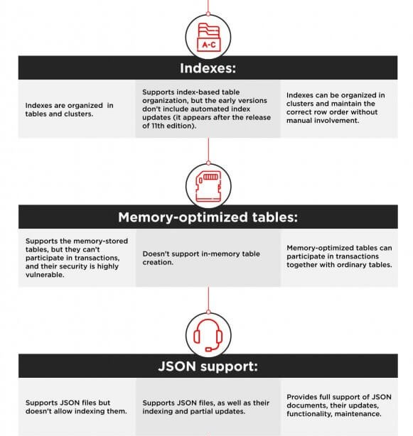

Slide 11
